Slide 1
AuraDB Knowledge Graph Creation
Endija Dārija Čapkovska, Emīls Bitāns, Maksims Ločs

Slide 2
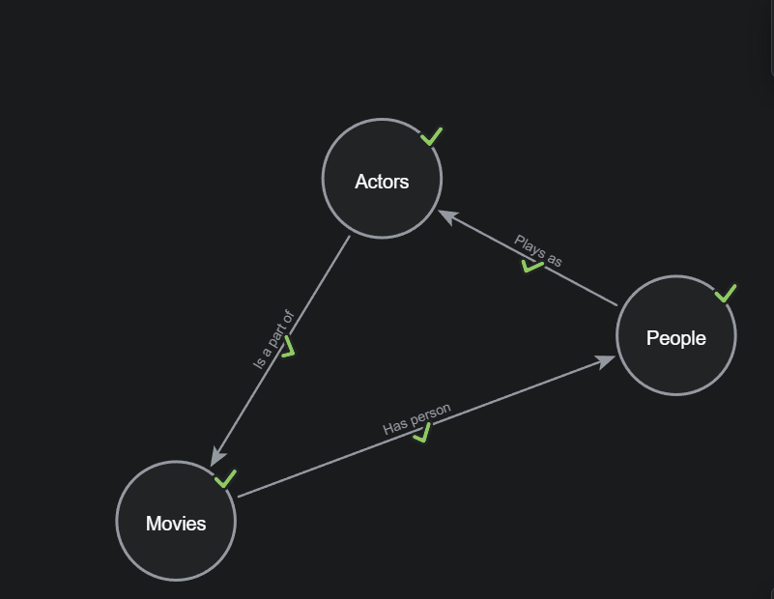
Import with relationships

Slide 3
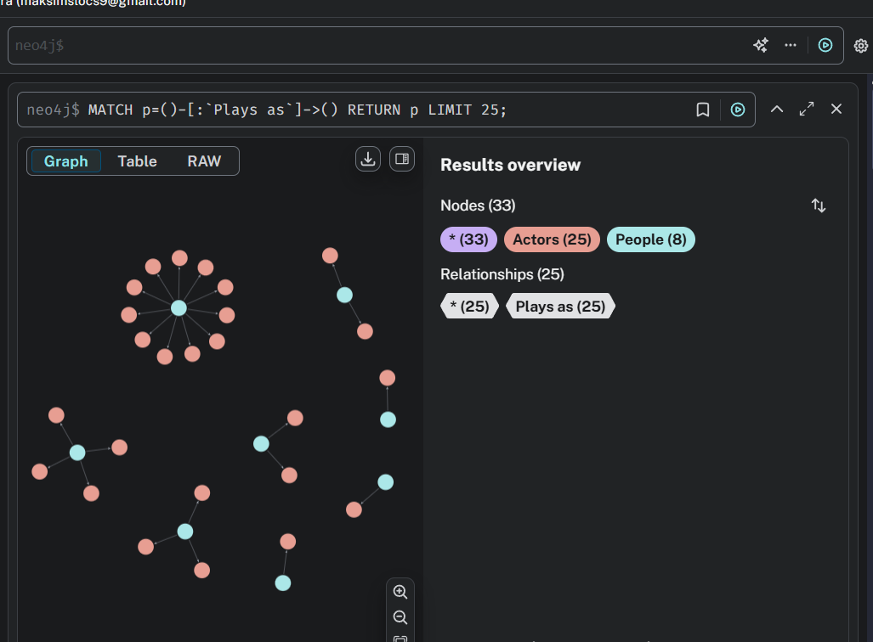
Query 1 – Person plays as Actor (role

Slide 4
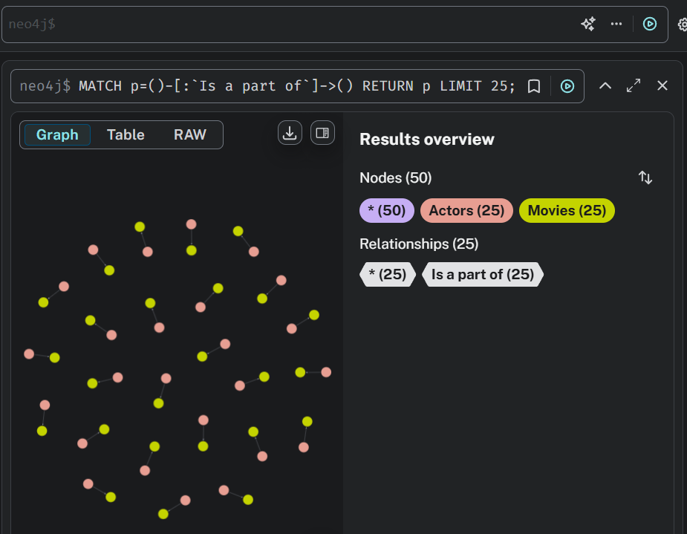
Query 2 – Actor (role) is a part of a Movie

Slide 5
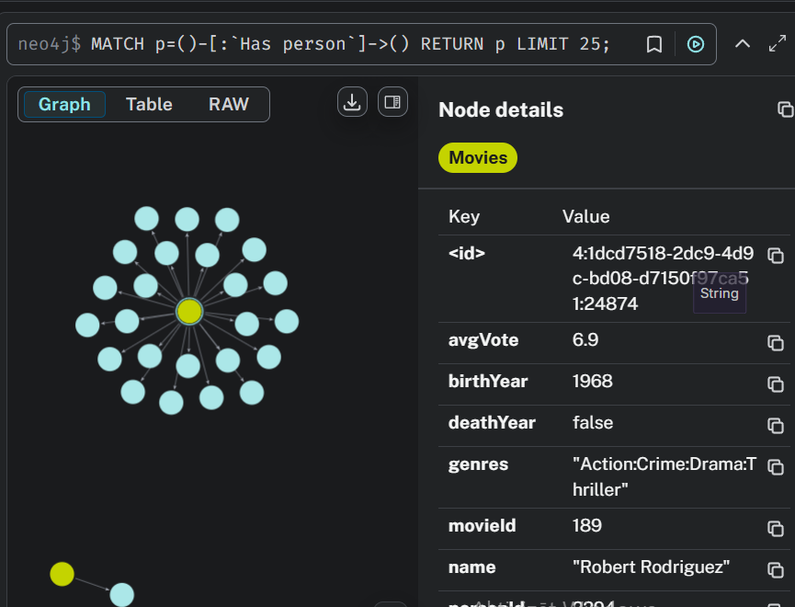
Query 3 – People that are acting in the movie

